Slide 1
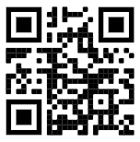
TopHat activities
Please join and indicate that you have done so:
https://app.tophat.com/login Join: 147651

Slide 2
Mid-term survey results

Slide 3

Overview of UML / Use Case diagrams & descriptions
CO1106 Requirements Engineering and Professional Practice
Dr Matthias Heintz
(mmh21@leicester.ac.uk)

Slide 4
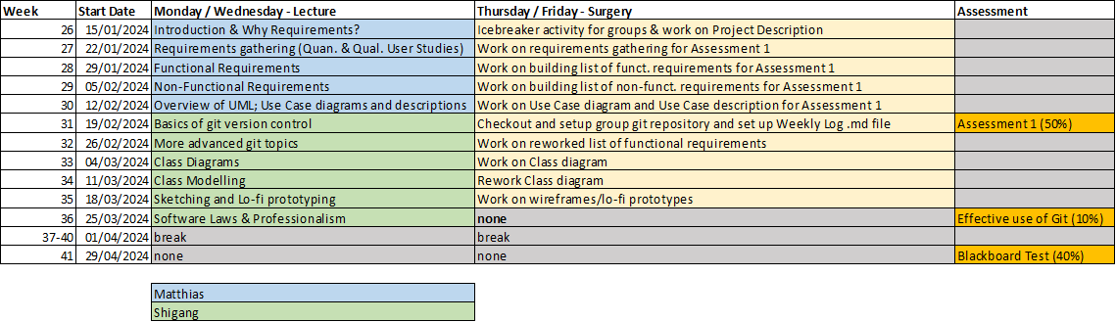
Schedule

Slide 5
Session objectives
At the end of the lecture you will be able to:
Explain what Unified Modelling Language (UML) is and why it is useful during software development projects
List different diagram types in UML and describe where they are applicable
Explain Use case models and construct them diagrammatically
Explain Use case descriptions and write them

Slide 6

Group coursework in CO1106
Main group project
Part 1 (50% - due 23rd February)
Project description (10%)
Quantitative and qualitative studies (10%)
Written requirements (20%)
Use Case UML Diagram and Use Case Description (10%)
Part 2 (10% - due 27th March)
Effective usage of git version control

Slide 7
Group Coursework Part 1 - Task 4 Use Case UML Diagram and Use Case Description (10% of module marks)
Overview
Create a Use Case diagram (.jpg format) containing all of the use cases for the group's system. Any diagramming tool that is available to you can be used to create this diagram. The diagram should be in .jpg format. Your group will receive a mark out of 5 for the quality of the submitted Use Case diagram.
Write one Use Case description, which will also be marked out of 5 based on the marking rubric in the assessment description. The description should relate to one of your system’s most unique / specialised use cases (i.e., don’t choose something generic, e.g., a ‘log-in’ process).

Slide 8
Instructions
Use Case UML Diagram and Use Case Description
Based on your project description and functional requirements:
Think about which use cases your system supports
Create a UML diagram containing those use cases
Write a use case description for one of the use cases
Notes:
Try to avoid group think, come up with 4 or 5 yourself, before taking them to the group

Slide 9
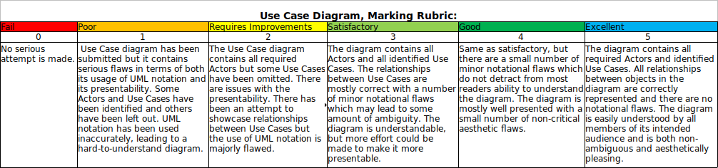
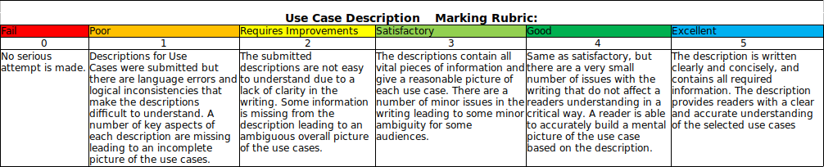
Marking rubrics
Notes:
for completeness: Please read in your own time and ask any questions during the next lecture or during surgeries

Slide 10
Modelling Systems

Slide 11
What is a system model?
A system model is an ‘abstract representation’ of a system that takes a particular perspective of that system and ignores irrelevant details.
A view is a perspective of a system, and view models allow us to focus on:
What a system does for its users/stakeholders (User view)
How a system is structured internally (Structural view)
How a system reacts to external influences (Behavioural view) and how its components interact with each other

Slide 12
Why would we want to model a system?
https://app.tophat.com/login Join: 147651
System modelling techniques enable us to:
Describe the use cases of a system to stakeholders in an understandable way
Build a concrete picture of a systems structure before programmers begin implementing it
Record design decisions and document how a system works
Remove unnecessary complexities during the design process

Slide 13

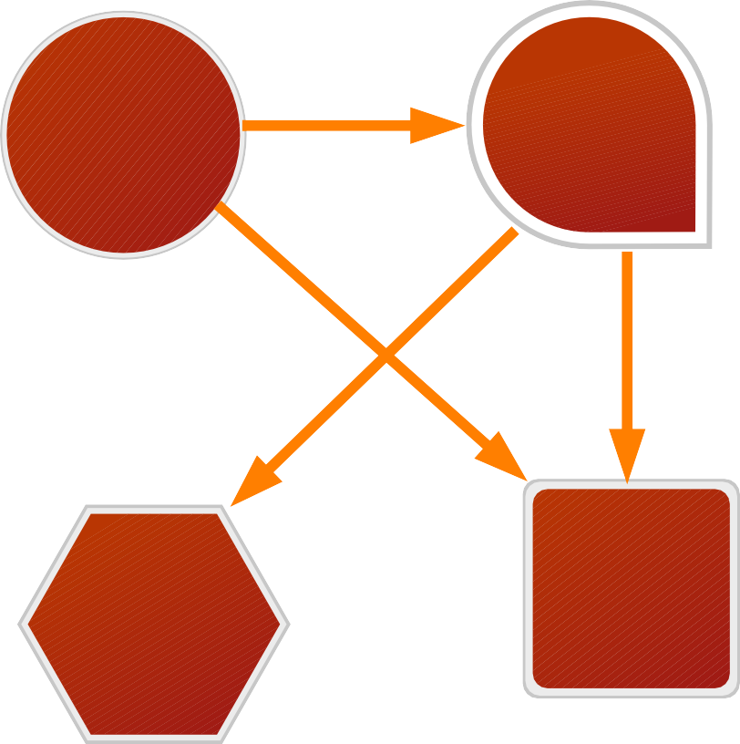



More on system views
User view
Users exist outside the system boundary and see the system as a ‘tool’ from which they can benefit
System
Structural view
Components constitute the system itself, and can be related to each other in a variety of ways
Components & interactions
Behavioural view
Interactions between internal components and with external sources define the system's behaviour

Slide 14

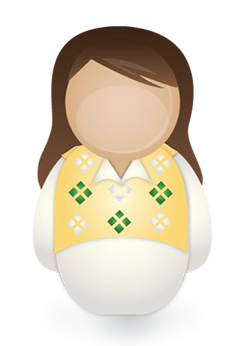








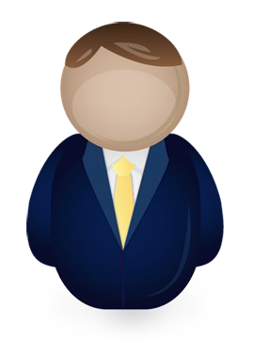





In CO1106, we’ll be learning about both the
User view
Structural view
&
and how to model them with diagrams

Slide 15
Unified Modelling Language

Slide 16

Unified Modelling Language (UML)
What is it?
A collection of formal diagramming notations useful for creating view models of systems
Why use it?
Allows us to form a blueprint of a given system in a standardised way
What’s included?
Use Case Diagrams; Class Diagrams; Sequence Diagrams; Activity Diagrams; State Diagrams
UML was original designed in 1998 engineers at a company called ‘Rational Software’ (bought out by IBM in 2003) in an attempt to standardise a number of disparate notational systems/approaches to software design/engineering.

Slide 17
Unified Modelling Language: Diagram types
UML diagram types generally belong to one of three different categories:
Functional: Concerned with a system’s functionality from the users viewpoint (i.e., what does the system provide to a user, or a user provide to it?)
Use Case Diagrams
Static/Structural: Concerned with objects that exist within a system’s boundary and how they relate to one another
Class Diagrams
Dynamic/Behavioural: Concerned with the behaviour of a system and its components over time
Sequence Diagrams, Activity Diagrams, State Diagrams
Notes:
Only Use Case Diagrams and Class Diagrams will be covered in this module, Sequence Diagrams, Activity Diagrams, and State Diagrams will not be covered.

Slide 18
Use Case Diagrams

Slide 19
Use Case Diagrams (UCD)
Use case diagrams are used to capture, formalise & visualise the usage scenarios of a given software system
They provide an easy-to-understand visual tool by which developers, domain experts & end-users can communicate
They serve as a basis for software testing
Contains a system’s use cases and chart the relationships between them and external actors (stakeholders/users)
Often supplemented with in-depth textual descriptions of each use case

Slide 20
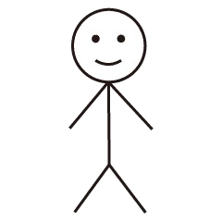
Use Case Diagrams: a generic example
Generic system
The System boundary represents a logical separation between a system’s internals and its outside influences. It is labelled by the system subject.
Actors represent external data sources / destinations
Use case 1
Actor 1
A line between an actor and a use case indicates that the actor participates in that Use Case
Use case 2
Actor 3
Use case 3
Use cases represent a unitary piece of functionality provided by the system to one of the actors
Actor 2

Slide 21
Use Case Diagrams: a concrete example
Bank ATM
Check balance
This UCD represents an online banking app
The identified actors are Customers, Technicians, and the Bank
The identified use cases are:
Let customers check their balance
Let customers deposit funds to their account
Let customers withdraw cash
Indicates when a repair to the software/hardware is needed
Deposit funds
Customer
Withdraw cash
Bank
Indicate maintenance needed
Technician

Slide 22









Elements of a UCD: Subject & system boundary
https://app.tophat.com/login Join: 147651
Subject is a business, software system, subsystem, component, device, etc. that we are designing or trying to understand
We choose an appropriate, non-ambiguous name that describes what the system does, e.g.:
Ticket dispenser
Parking meter
The system boundary (the rectangular box), encapsulates the services a system provides and separates these from who/what it provides these services to

Slide 23
Elements of a UCD: Actors
https://app.tophat.com/login Join: 147651
An actor represents a set of roles that are assumed by users of the system when they interact with a particular subset of its use cases
An actor is not necessarily a human being – it can be
A human
Another system
A physical sensor
A hardware device
Etc.
Actors are entities that interact with the system to obtain data (they’re a data destination for the system) or provide data (they’re a data source for the system)
Actors are always external to the system – they never appear within the system boundary
We use a stick figure, annotated with a name to denote an Actor
Actor name
Notes:
We use a stick figure, even if the actor is not a human being!

Slide 24


Actors represent roles, not individuals
Note that an Actor does not denote a particular instance of an entity
Rather, it denotes one of many possible roles assumed by entities that interact with the system
Jim
Check balance
Hence, Jim can assume the role of both Customer and Technician
Customer
...
...
...
works as a computer technician for the bank, but is also a registered customer for that bank
Indicate maintenance needed
Technician

Slide 25
Identifying Actors
Consider your project description & functional requirements and ask the following questions:
Who / what does the system provide data / value to by helping them complete a task or fulfil a goal? (i.e., who are the stakeholders in your system)
Who / what provides data to the system to help it fulfil a requirement?

Slide 26
Exercise: Identifying Actors

Slide 27
Exercise (5 min)
Consider the following description of the Bank ATM system and identify the use case, primary actors and secondary actors. Draw a UCD showing the relationships between them.
“… the bank customer selects to withdraw cash from the ATM and specifies the amount of money that they’d like to withdraw. This information is transferred to the Bank’s central information system, which verifies that the user has sufficient funds in their account for the specified withdrawal amount. The bank’s answer is transferred back to the ATM, which releases the funds if the Bank says ‘yes’, or displays an ‘Insufficient funds’ message if the bank says no...”
Notes:
Primary actors = “active actors”, who can initiate a use case
Secondary actors = “passive actors”, who are used by the system

Slide 28
Solution to exercise:
Bank ATM
Withdraw cash
“… the bank customer selects to withdraw cash from the ATM and specifies the amount of money that they’d like to withdraw. This information is transferred to the Bank’s central information system, which verifies that the user has sufficient funds in their account for the specified withdrawal amount. The bank’s answer is transferred back to the ATM, which releases the funds if the Bank says ‘yes’, or displays an ‘Insufficient funds’ message if the bank says no...”
Bank
Bank
customer
informationsystem
Notes:
In a UCD, we do not visually distinguish between primary and secondary actors (why?)
Instead, we use a detailed ‘use case description’ which contains the information (we’ll discuss this later)
User stories are also a useful tool for identifying primary actors for a particular use case
Use case
Primary actor
Secondary actor
Notes:
Why?
Because their classification is use-case-dependent,

Slide 29
About ‘non-human’ actors
Actors are not required to be human, for example they could also be an interfacing hardware system or software system
Identifying non-human actors can be a bit more difficult; for example...
Example: An operating system (OS) is a piece of software that allows the users of a computer to interact with the system. They typically have a ‘log-in’ feature. In order to use that, the user enters their account password via a keyboard.
Operating system
...
...
...
Customer
Question: Should we include the keyboard as an actor in our diagram?
Log-in
...
...
...
Keyboard
Notes:
Question: Should we include the keyboard as an actor in our diagram?
Hands up if you think “yes”.
Hands up if you think “no”.

Slide 30
About ‘non-human’ actors
Actors are not required to be human, for example they could also be an interfacing hardware system or software system
Identifying non-human actors can be a bit more difficult; for example...
Example: An operating system (OS) is a piece of software that allows the users of a computer to interact with the system. They typically have a ‘log-in’ feature. In order to use that, the user enters their account password via a keyboard.
Operating system
...
...
...
Customer
Question: Should we include the keyboard as an actor in our diagram?
Log-in
Answer: No – this overcomplicates matters because the customer always uses the keyboard to interact with the OS
...
...
...
So, we abstract away this information in the UCD
Keyboard
Notes:
Question: Should we include the keyboard as an actor in our diagram?
Hands up if you think “yes”.
Hands up if you think “no”.

Slide 31
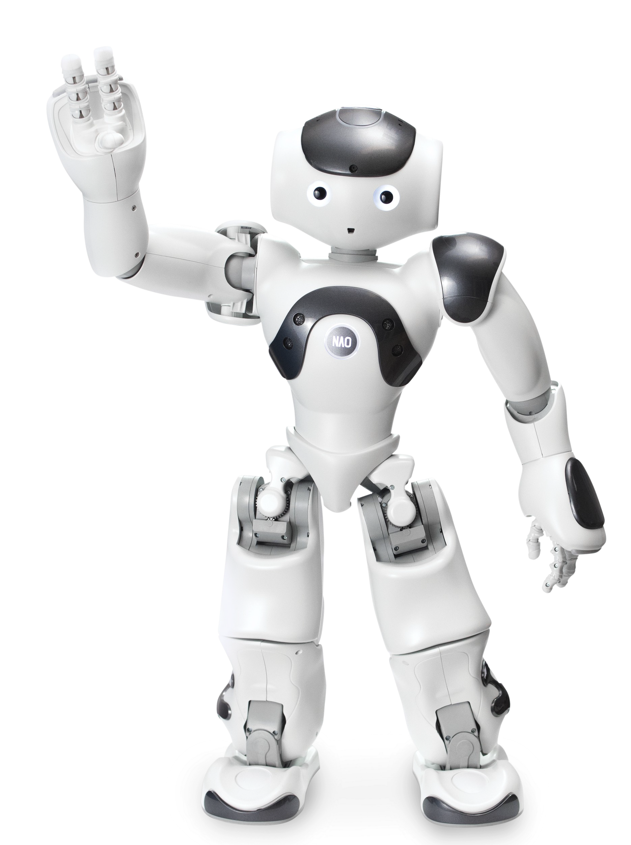
Identifying ‘non-human’ actors
A rule of thumb when trying to identify non-human actors is to add a ‘thing’ as an actor to your diagram whenever:
‘It’ initiates contact with the system in question
‘It’ obtains value from contacting your system
‘It’ is the exclusive source of some information that is needed by your system

Slide 32
Elements of a UCD: Use Cases
Each use case specifies a unit of complete functionality that the system provides to actors (what the system does – not how it does it)
Each use case should reflect the needs & goals of system stakeholders
The use cases in a system’s use case diagram should mirror the functional requirements of the system
Schedule appointment
Something that the system
enables its end users to do
Hire car
,
Deposit cash
,
Make reservation
Purchase ticket
Return book
,
,

Slide 33



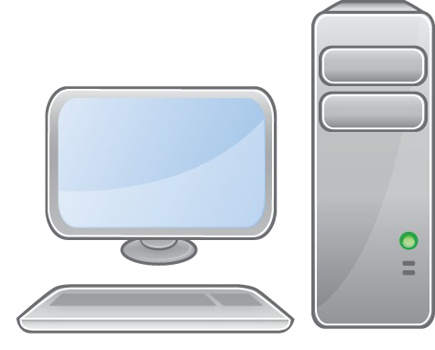


Use cases encapsulate a ‘set of scenarios’
Each use case can be associated with a multitude of ‘sequences of interactions’ and the system doesn’t always behave the same for each
Example: Student A & Student B both want to reserve books using the libraries online catalogue;
The system checks and finds that there is 1 copy of A’s book, so the system completes the reservation, but there are no copies of B’s book left, so the system shows an error message.
Online library catalogue
Student A
Reserve book
Patron
Both of these ‘scenarios’ are encapsulated by the ‘Reserve book’ use case. This information should be captured in a Use Case Description (more on that later).
Student B

Slide 34
Use case relationships: <<extends>>
Since one particular use case can represent a multitude of different scenarios resulting in different system behaviour, we want a way to represent this
We can do this using the ‘<<extends>>’ notation:
The ‘base use case’ should always work as a stand-alone use case, but under certain conditions it may result in the ‘extending use case’ happening
The notation should be read as: “The ‘Extending use case’ is a more specific case of the ‘Base use case’
Use of the <<extends>> relationship is optional; use it only when it makes sense
Extending use case
<<extends>>
Base use case

Slide 35
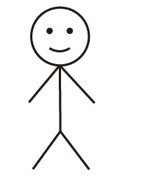
The <<extends>> relationship: an example
Consider a simple, online ticket booking system
Two different options of booking seat tickets or standing tickets for a concert can be represented using the <<extends>> relationship:
Online ticket booking system
<<extends>> is typically used to specify less common sub scenarios where system behaviour differs significantly from the base case
<<extends>>
Book seated tickets
Book tickets
<<extends>>
Book standing tickets
Customer

Slide 36
Use case relationships: <<includes>>
The <<includes>> relationship is used to indicate when one use case explicitly incorporates the behaviour of another use case:
This should be read as: “Whenever Use case X happens, Use case Y happens as a subcase of X”
This is particularly useful when two use cases include a common ‘sub- use case’...
<<includes>>
Use case X
Use case Y

Slide 37
The <<includes>> relationship: an example
Online catalogue
Extend book loan
Both the ‘Extend book loan’ and ‘Reserve book’ use cases require the user to first check for existing reservations
The <<includes>> relationship can help us to identify aspects of our system where functionality can be reused to serve multiple purposes
<<includes>>
Check for existing reservation
Reserve book
<<includes>>
Patron

Slide 38
Exercise: Identifying Relations

Slide 39
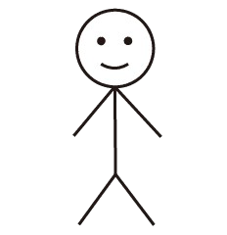
Class exercise (~5 min)
Bank ATM
Check balance
Consider this modified version of the ‘Bank ATM’ use case diagram that we looked at earlier and do the following:
Add instances of the <<includes>> and <<extends>> relationships where appropriate
Decide which use cases the ‘Bank’ actor should be connected to
Withdraw cash
Enter PIN
Customer
Bank
Update account balance
Deposit funds
Request maintenance check
Indicate repair needed
Technician

Slide 40
Class exercise: solution
Bank ATM
Check balance
Notes:
Instances of the <<includes>> relationship are indicated by a red arrow
Instances of the <<extends>> relationship are indicated by a blue arrow
This is done for readability of the solution, you need to label them accordingly, not use different colours!
This is just one possible solution! As long as you can justify your design choices, a different solution is fine
Withdraw cash
Enter PIN
Customer
Bank
Update account balance
Deposit funds
Request maintenance check
Indicate repair needed
Technician

Slide 41
A word of warning
One of the benefits of Use Case Diagrams is that they are easy to understand
This makes them a good visual aid to show to ‘non-expert’ stakeholders
Use of the <<extends>> and <<includes>> notations can complicate a diagram, so use them with care
For the assignment, any use of these notations must be justified and logically sound
If in doubt, get feedback in the tutorial session

Slide 42
Use Case Description

Slide 43




Use Case Descriptions
The UC diagram itself does not always provide all the information we need about the system
We supplement it by associating a textual description with each individual use case (called a ‘Use Case Description’, UCD)
To write a description for a given use case, we consider the use case in- depth and document all that we know about it...
Use case X

Slide 44
Use Case Descriptions: what to include?
There is no widely accepted standard format for writing a use case description but one should include:
7. Typical flow of events: describe the most typical scenario associated with this use case; indicate where other use case behaviours are
<<include>>d
1. Use case name
4. Related requirements: which of your functional requirements does the use case satisfy
2. Purpose: what is the end goal of the use case?
5. Actors involved: who are the primary/secondary actors for this use case?
8. Alternative event flows: what sub-scenarios are there? Think about if and where you’ve <<extend>>ed the use case
6. Priority: how important is it that the use case is implemented? Think: must, should, could...
3. Author/date: provide information about who documented the use case

Slide 45
Take a look at the ‘example use case description’ on the Blackboard page for Week 5 for ideas / inspiration

Slide 46
Determining use cases and their participators
Identify the system’s actors and establish what each actor wants from the system
Remember to make sure that the use cases represent functionality of the system that a user benefits from
Write a short paragraph describing each use case; this should help you to identify who participates in each one
When you identify a certain actor is involved in such a sequence, draw a line between that actor and the use case

Slide 47
Using your UCDs to decide when to use use case relationships
<<includes>>: Use whenever two or more use case descriptions always include a common piece of functionality...
e.g., a hot drinks machine:
<<extends>>: Use whenever one ‘stand-alone’ use case is a specialised case of another
<<includes>> <<includes>>
Dispense
soup
Dispense hot water
Dispense coffee
Dispense coffee with sugar
<<extends>>
Remember not to
overcomplicate things & use these relationships with caution!
Dispense coffee

Slide 48

Making model design choices
When making design choices, the best thing to do is use your common sense and justify your model choices
There will usually be a multitude of ways to represent a particular aspect of a system
It’s your job as the engineer to decide how each aspect is represented
Try to make your model as simple as possible

Slide 49

What’s next?
Based on your project description and your functional requirements you should now generate the Use Case UML diagram and a Use Case description for your group project
Receive feedback on your progress during the surgeries
Lecture next week: Basics of git version control

Slide 50

Questions?
Dr. Matthias Heintz
mmh21@leicester.ac.uk
Microsoft Teams
Office 613 in Ken Edwards Building

